Slide 1
Topic 18 The Rankine Cycle
Thermodynamics: An Engineering Approach
8th Edition Yunus A. Çengel, Michael A. Boles
McGraw-Hill, 2015

Slide 2
Objectives
Evaluate the performance of gas power cycles for which the working fluid remains a gas throughout the entire cycle.
Analyze vapor power cycles in which the working fluid is alternately vaporized and condensed.
Investigate ways to modify the basic Rankine vapor power cycle to increase the cycle thermal efficiency.

Slide 3

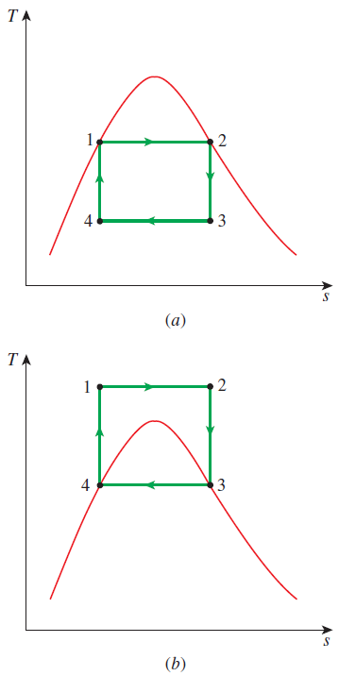
THE CARNOT VAPOR CYCLE
The Carnot cycle is the most efficient cycle operating between two specified temperature limits but it is not a suitable model for power cycles. Because:
Process 1-2 Limiting the heat transfer processes to two-phase systems severely limits the maximum temperature that can be used in the cycle (374°C for water)
Process 2-3 The turbine cannot handle steam with a high moisture content because of the impingement of liquid droplets on the turbine blades causing erosion and wear.
Process 4-1 It is not practical to design a compressor that handles two phases.
The cycle in (b) is not suitable since it requires isentropic compression to extremely high pressures and isothermal heat transfer at variable pressures.
1-2 isothermal heat addition in a boiler
2-3 isentropic expansion in a turbine
3-4 isothermal heat rejection in a condenser
4-1 isentropic compression in a compressor

Slide 4
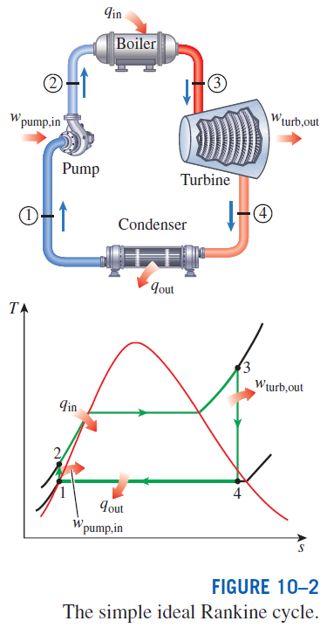
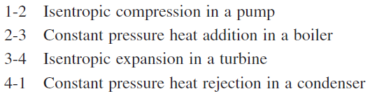
RANKINE CYCLE: THE IDEAL CYCLE FOR VAPOR POWER CYCLES
Many of the impracticalities associated with the Carnot cycle can be eliminated by superheating the steam in the boiler and condensing it completely in the condenser.
The cycle that results is the Rankine cycle, which is the ideal cycle for vapor power plants. The ideal Rankine cycle does not involve any internal irreversibilities.

Slide 5
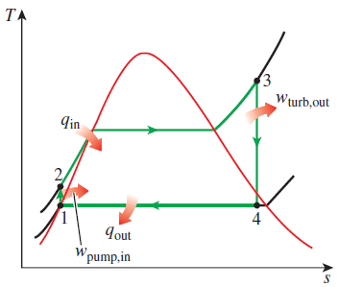
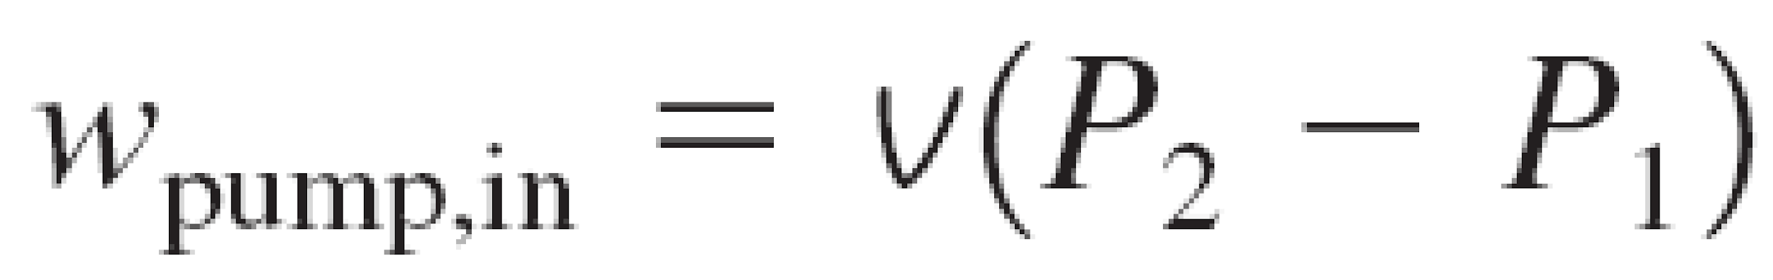

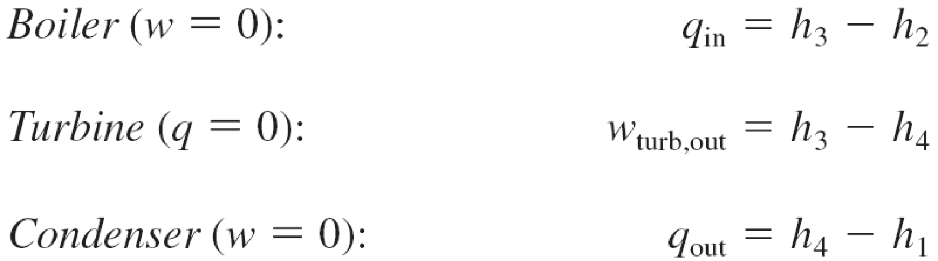

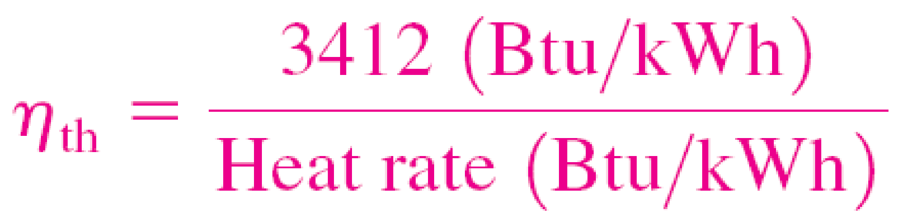
Energy Analysis of the Ideal Rankine Cycle
Steady-flow energy equation
The efficiency of power plants in the U.S. is often expressed in terms of heat rate, which is the amount of heat supplied, in Btu’s, to generate 1 kWh of electricity.
The thermal efficiency can be interpreted as the ratio of the area enclosed by the cycle on a T-s diagram to the area under the heat-addition process.

Slide 6
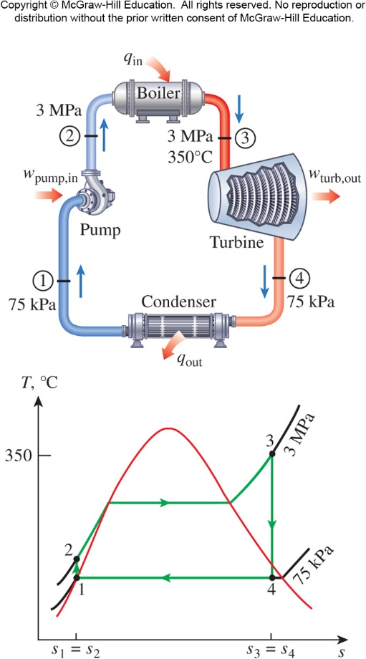
The Simple Ideal Rankine Cycle
Solution
Consider a steam power plant operating on the simple ideal Rankine cycle. Steam enters the turbine at 3 MPa and 350ºC and is condensed in the condenser at a pressure of 75 kPa. Determine the thermal efficiency.

Slide 7
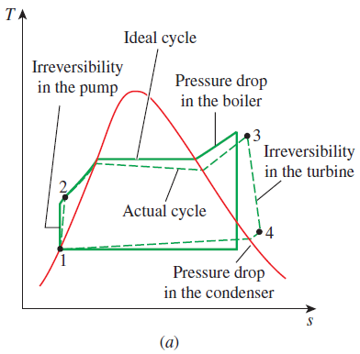
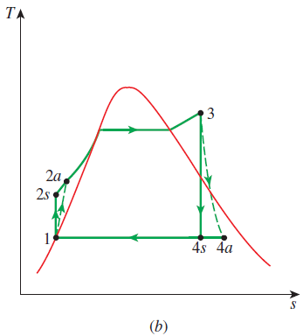
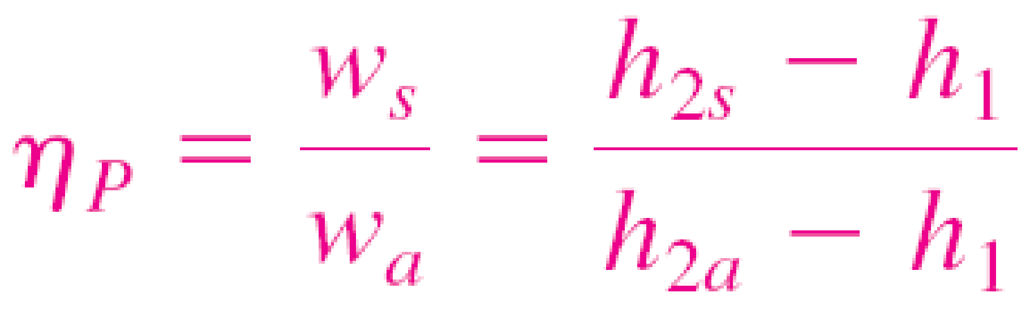
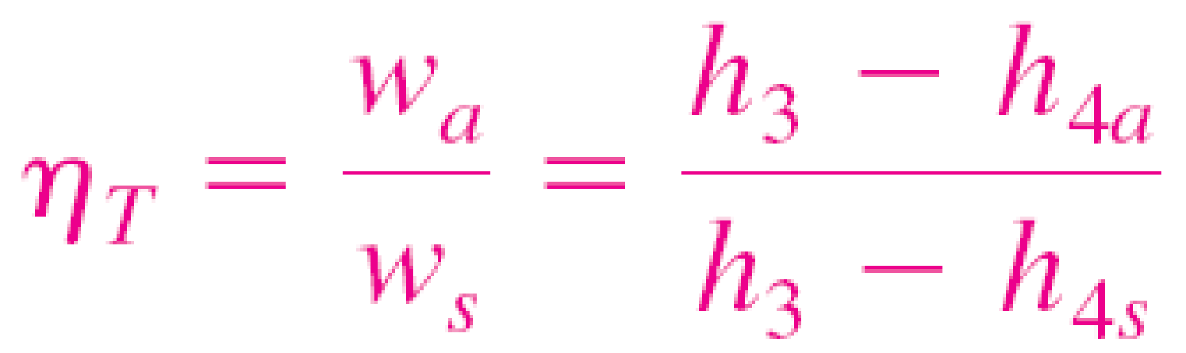
DEVIATION OF ACTUAL VAPOR POWER CYCLES FROM IDEALIZED ONES
The actual vapor power cycle differs from the ideal Rankine cycle as a result of irreversibilities in various components.
Fluid friction and heat loss to the surroundings are the two common sources of irreversibilities.
Isentropic efficiencies
(a) Deviation of actual vapor power cycle from the ideal Rankine cycle. (b) The effect of pump and turbine irreversibilities on the ideal Rankine cycle.

Slide 8
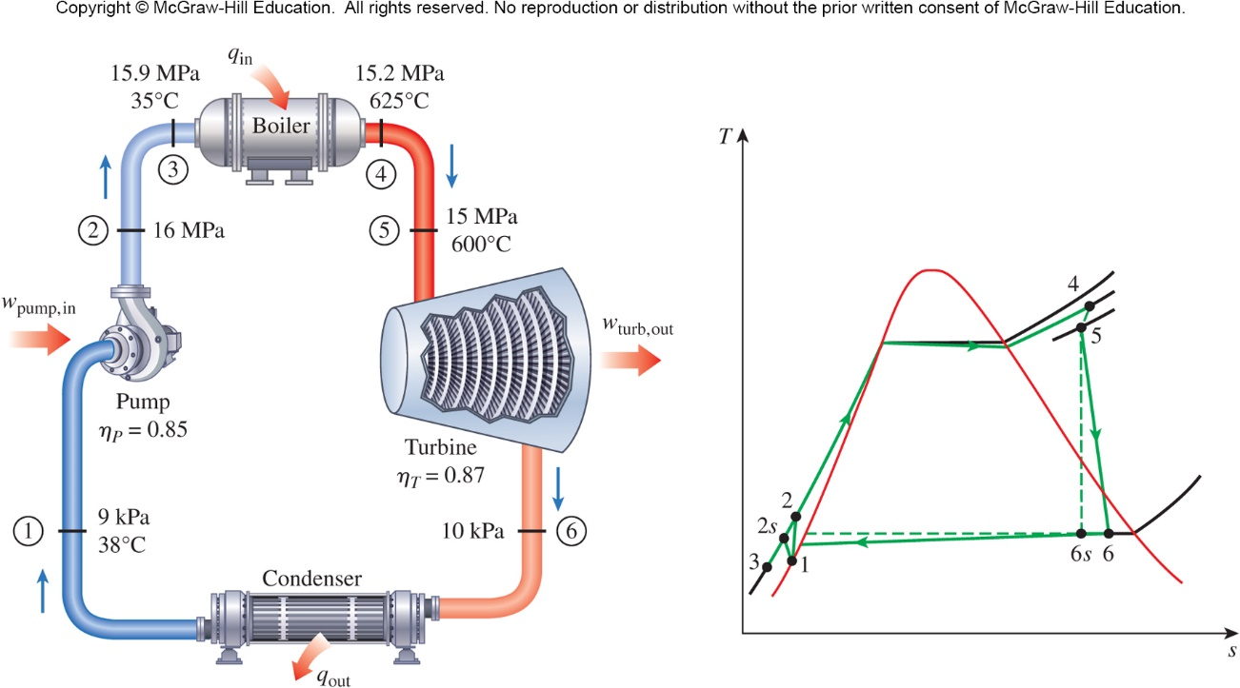
An Actual Steam Power Cycle
Solution
A steam power plant operates on the cycle shown below. If the isentropic efficiency of the turbine is 87% and the isentropic efficiency of the pump is 85%, determine the thermal efficiency of the cycle and the net power output for a mass flow rate of 15 kg/s.

Slide 9
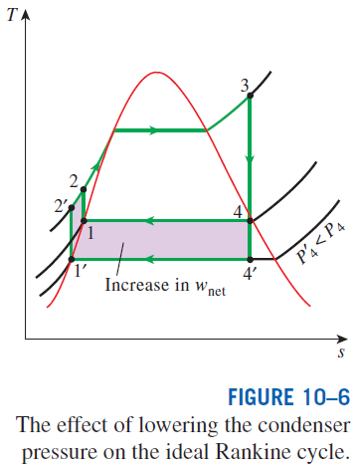
HOW CAN WE INCREASE THE EFFICIENCY OF THE RANKINE CYCLE?
The basic idea behind all the modifications to increase the thermal efficiency
of a power cycle is the same: Increase the average temperature at which heat is transferred to the working fluid in the boiler, or decrease the average temperature at which heat is rejected from the working fluid in the condenser.
Lowering the Condenser Pressure (Lowers T_{low,avg})
To take advantage of the increased efficiencies at low pressures, the condensers of steam power plants usually operate well below the atmospheric pressure. There is a lower limit to this pressure depending on the temperature of the cooling medium
Side effect: Lowering the condenser pressure increases the moisture content of the steam at the final stages of the turbine.

Slide 10
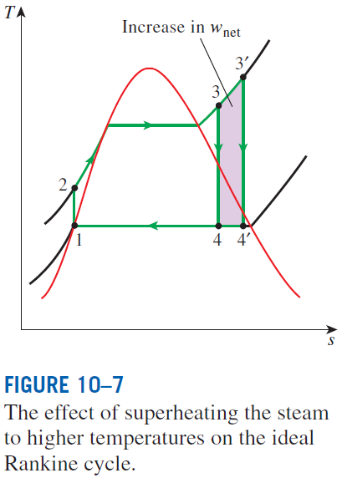
Superheating the Steam to High Temperatures (Increases T_{high,avg})
Both the net work and heat input increase as a result of superheating the steam to a higher temperature. The overall effect is an increase in thermal efficiency since the average temperature at which heat is added increases.
Superheating to higher temperatures decreases the moisture content of the steam at the turbine exit, which is desirable.
The temperature is limited by metallurgical considerations. Presently the highest steam temperature allowed at the turbine inlet is about 620°C.

Slide 11
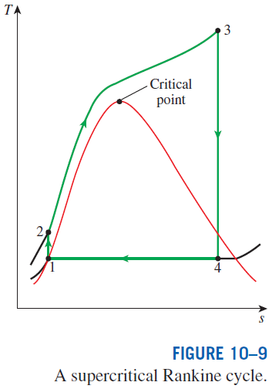
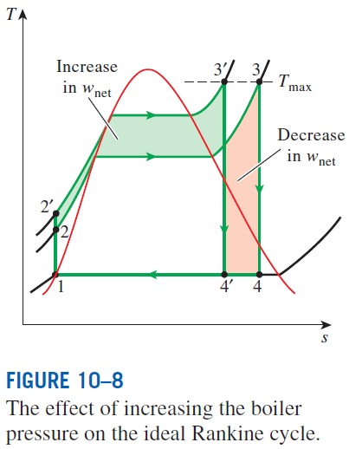
Increasing the Boiler Pressure (Increases T_{high,avg})
Today many modern steam power plants operate at supercritical pressures (P > 22.06 MPa) and have thermal efficiencies of about 40% for fossil-fuel plants and 34% for nuclear plants.
For a fixed turbine inlet temperature, the cycle shifts to the left and the moisture content of steam at the turbine exit increases. This side effect can be corrected by reheating the steam.

Slide 12
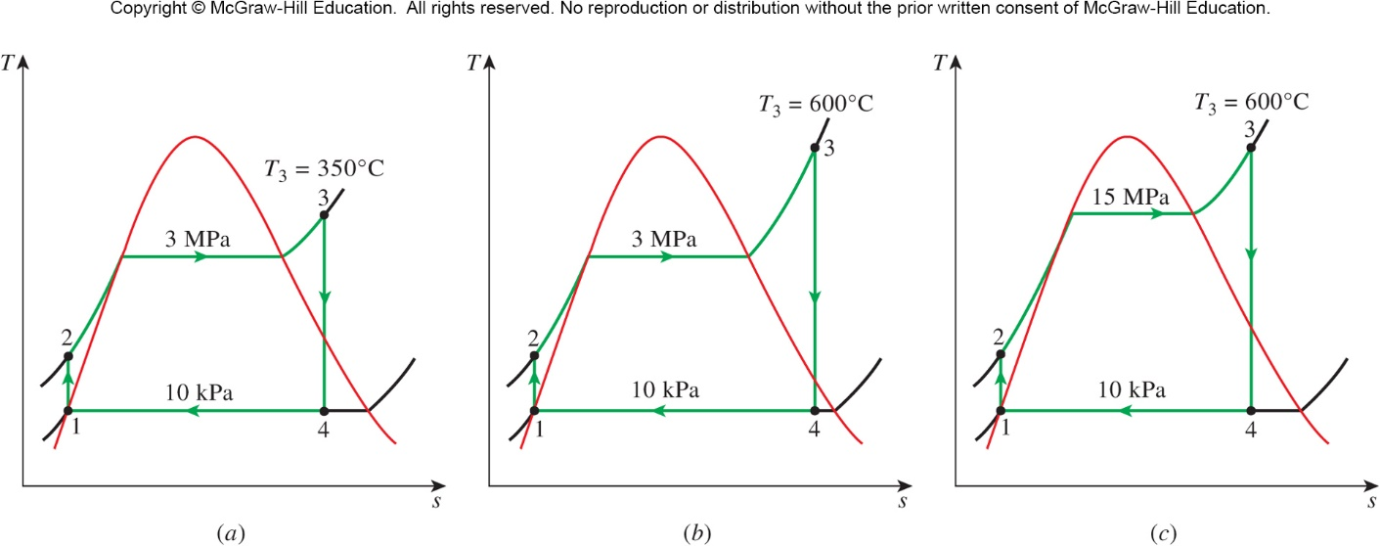
Effect of Boiler Pressure and Temperature on Efficiency
Solution
Consider a steam power plant operating on the ideal Rankine cycle. Steam enters the turbine at 3 MPa and 350ºC and is condensed in the condenser at a pressure of 10 kPa. Determine the thermal efficiency of the power plant (a) under these operation parameters, (b) if the steam is superheated to 600ºC instead of 300ºC, and (c) if the boiler pressure is raised to 15 MPa while the steam is superheated to 600ºC.

Slide 13
Solution
 | Part A | Part B | Part C
Boiler Pressure | 3 MPa | 3 MPa | 15 MPa
Boiler Temperature (exit) | 350ºC | 600ºC | 600ºC
Steam Quality (turbine exit) | 81.3% | 91.5% | 80.4%
Thermal Efficiency | 33.4% | 37.3% | 43.0%

Slide 14
Summary
The Carnot vapor cycle
Rankine cycle: The ideal cycle for vapor power cycles
Energy analysis of the ideal Rankine cycle
Deviation of actual vapor power cycles from idealized ones
How can we increase the efficiency of the Rankine cycle?
Lowering the condenser pressure (Lowers T_{low,avg})
Superheating the steam to high temperatures (Increases T_{high,avg})
Increasing the boiler pressure (Increases T_{high,avg})

